Slide 1
科研总结及汇报
Presenter: 周池 (Amelie)
2017 Mar 27

Slide 2
个人情况
2016.5 – 2017.8 法国国家信息与自动化研究所 博士后
2015.8 – 2016.4 南洋理工大学 助理研究员
2011.8 – 2015.7 南洋理工大学 博士
2009.9 – 2011.7 北京航空航天大学 硕士
2005.9 – 2009.7 北京航空航天大学 本科

Slide 3
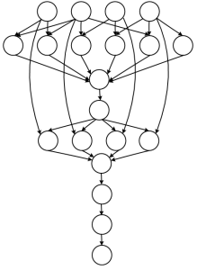
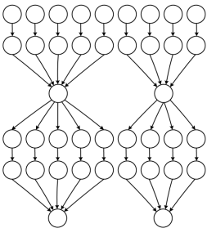


研究方向
关键词：云计算平台，大数据应用
云计算平台
  资源调度：考虑不同的资源类型，不同的优化目标
  性能不稳定性：考虑性能的概率分布
大数据应用
  科学计算数据流(scientific workflow)
    Loosely coupled
    Modeled as DAG
    Tasks have different behaviors.
  图处理(graph processing)
Montage
Ligo

Slide 4
云平台上针对科学数据流的资源调度
ToF (IEEE TCC)
  通用的数据流结构转换模型
  兼顾性能及成本的优化目标
Deco (HPDC 2015)
  用于描述数据流优化问题的申诉式语言
  考虑了云性能不稳定对优化结果的影响

Slide 5
ToF: A Transformation-based Optimization Framework
Core design ideas
  A series of common transformations for the performance and cost optimizations of workflows
    Main schemes: reduce cost
    Auxiliary schemes: help main schemes to reduce cost
  A light-weight optimizer to guide the transformation process.
D = 120min
Only transforms shape
Reduces cost
1
30min
40min
30min
40min
40min
110min
0
0
1
0
1
2
0
1
2
2
2
Move
Merge
Charging hours: $1+1+1=3$ →$\left\lceil (30+40+40)/60\right\rceil =2$

Slide 6
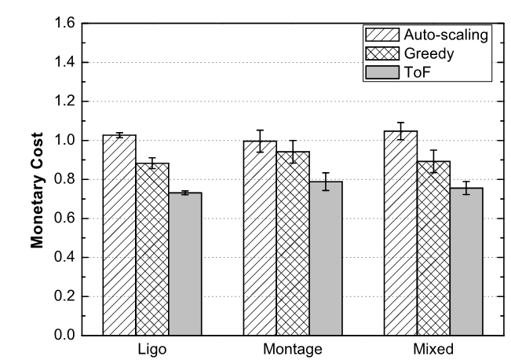
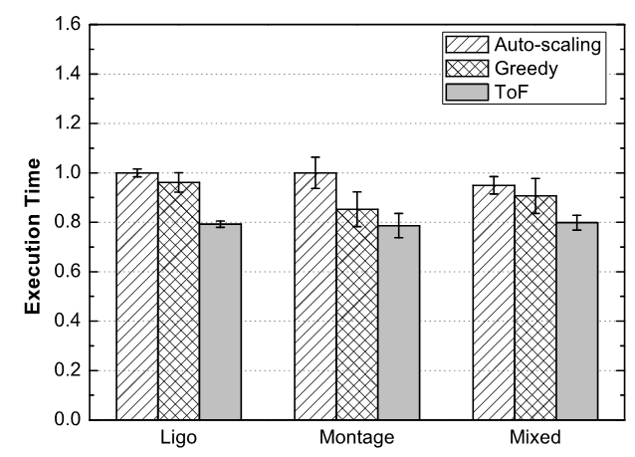
Evaluation Results
Cost and performance optimization results
  ToF reduces average monetary cost by 29% over Auto-scaling
  ToF reduces average execution time by 21% over Auto-scaling
29%
21%
Monetary cost optimizations on Montage, Ligo and Mixed workflows on Amazon EC2.
Performance optimizations on Montage, Ligo and Mixed workflows on Amazon EC2.

Slide 7
云平台上针对科学数据流的资源调度
ToF (IEEE TCC)
  通用的数据流结构转换模型
  兼顾性能及成本的优化目标
Deco (HPDC 2015)
  用于描述数据流优化问题的申诉式语言
  考虑了云性能不稳定对优化结果的影响

Slide 8
Deco: A Declarative Optimization Framework
A declarative programming language WLog (extended from ProLog)
  Keywords for optimization goals, constraints and variables.
  Workflow- and cloud-specific facts for programmability.
    import(daxfile) and import(cloud)
  Support probabilistic notion of performance/cost to capture cloud dynamics.
Notes:
Thus, it motivates us to develop a declarative optimization engine. Particularly, we have developed a declarative programming language extended from Prolog. Wlog has the following three features. First, we have developed a probabilistic notions for performance/cost to capture cloud dynamics. Rather than predicting the actual value, we model the performance (for example, network bandwidth) as a distribution. Thus, we use the distribution to perform the performance/cost optimization.
The second extension is to allow users to specify the goals, constraints and optimization variables.
Lastly, we offer workflow and cloud-specific facts for import into the system.
The optimization space is large when considering all VM types and probabilistic calculations. We tame the large search space issue in two techniques. First, we formulate the search problem as an A*search strategy to prune the unnecessary solution space. Second, we use GPU accelerations to reduce the overhead.
as a user-defined scheduler

Slide 9
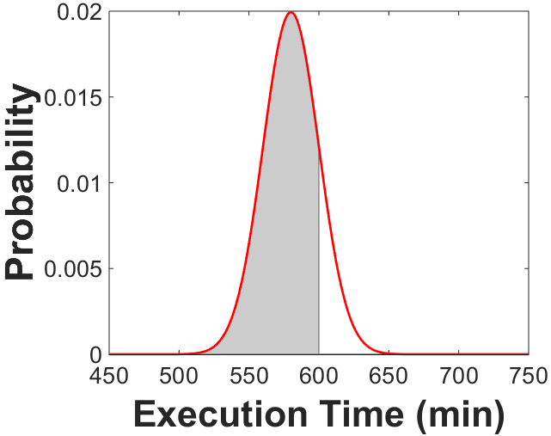
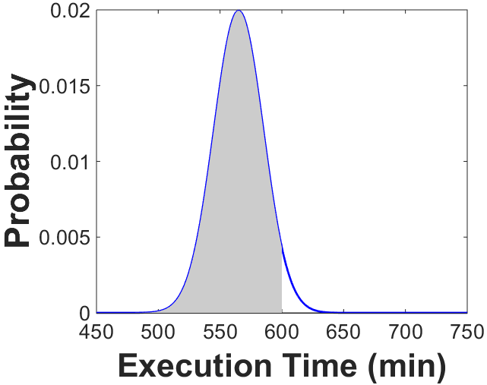
Deco: A Declarative Optimization Framework
A declarative programming language WLog (extended from ProLog)
  Keywords for optimization goals, constraints and variables.
  Workflow- and cloud-specific facts for programmability.
    import(daxfile) and import(cloud)
  Support probabilistic notion of performance/cost to capture cloud dynamics.
    𝑃(𝑡_𝑤≤600 𝑚𝑖𝑛𝑠)≥95%: A probabilistic deadline of 600 minutes with 95% guarantee.
Violated
Satisfied
96%
85%
Notes:
Thus, it motivates us to develop a declarative optimization engine. Particularly, we have developed a declarative programming language extended from Prolog. Wlog has the following three features. First, we have developed a probabilistic notions for performance/cost to capture cloud dynamics. Rather than predicting the actual value, we model the performance (for example, network bandwidth) as a distribution. Thus, we use the distribution to perform the performance/cost optimization.
The second extension is to allow users to specify the goals, constraints and optimization variables.
Lastly, we offer workflow and cloud-specific facts for import into the system.
The optimization space is large when considering all VM types and probabilistic calculations. We tame the large search space issue in two techniques. First, we formulate the search problem as an A*search strategy to prune the unnecessary solution space. Second, we use GPU accelerations to reduce the overhead.
as a user-defined scheduler

Slide 10
广域网下的图切割问题 (ICDCS 2017)
研究动机
  广域网带宽有限
  广域网上传下载带宽的不对称性
  图处理中数据传输量的不对称性
问题模型
  Streaming-based edge assignment to different datacenters (vertex-cut problem)
  Goal: minimize cross-datacenter data transfer time
  Constraint: WAN usage smaller than budget

Slide 11








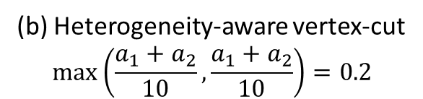

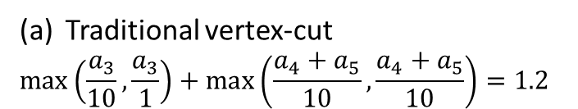

广域网下的图切割问题 (ICDCS 2017)
Core design idea
  Heterogeneity-aware vertex-cut
1
4
Master replica
 | DC1 | DC2
Uplink (MB/s) | 10 | 10
Downlink (MB/s) | 10 | 1
0
3
Mirror replica
2
5
Data transfer
1
$$a_{3}$$
WAN
$$a_{3}$$
4
1
WAN
4
$$a_{1}$$
$$a_{1}$$
1
0
3
3
0
3
$$a_{4}$$
$$a_{4}$$
5
$$a_{2}$$
$$a_{2}$$
避免用到bottleneck link
2
2
2
5
DC1
$$a_{5}$$
$$a_{5}$$
DC2
DC1
DC2
Traditional vertex-cut
$$\max\left(\frac{a_{3}}{10},\frac{a_{3}}{1}\right)+\max\left(\frac{a_{4}+a_{5}}{10},\frac{a_{4}+a_{5}}{10}\right)=1.2$$
(b) Heterogeneity-aware vertex-cut
$$\max\left(\frac{a_{1}+a_{2}}{10},\frac{a_{1}+a_{2}}{10}\right)=0.2$$

Slide 12
研究计划
Privacy-preserving in geo-distributed datacenters
  Collaborator: Amr Abbadi (UCSB), Tristan Allard (Univ. Rennes 1)
Probabilistic optimization in HPC
  CPU performance variation in HPC [ICS’16]
  I/O performance variation due to interferences [IPDPS’16]
Energy efficiency of big data applications
  Energy is the main operational cost for clouds.
  Trade-off between performance and energy during job execution.

Slide 13
B⁺-Tree知识点试讲
Lecturer: 周池 (Amelie)
2017 Mar 27

Slide 14
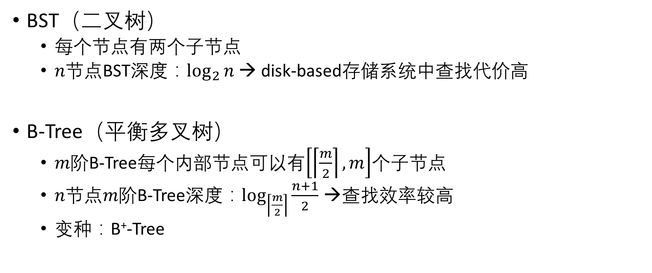
Revisit: BST and B-Tree
BST（二叉树）
  每个节点有两个子节点
  $n节点$BST深度：$\log_{2}{n}$ → disk-based存储系统中查找代价高
B-Tree（平衡多叉树）
  $m阶$B-Tree每个内部节点可以有$\left[\left\lceil \frac{m}{2}\right\rceil ,m\right]$个子节点
  $n节点m阶$B-Tree深度：$\log_{\left\lceil \frac{m}{2}\right\rceil }{\frac{n+1}{2}}$ →查找效率较高
  变种：B⁺-Tree

Slide 15
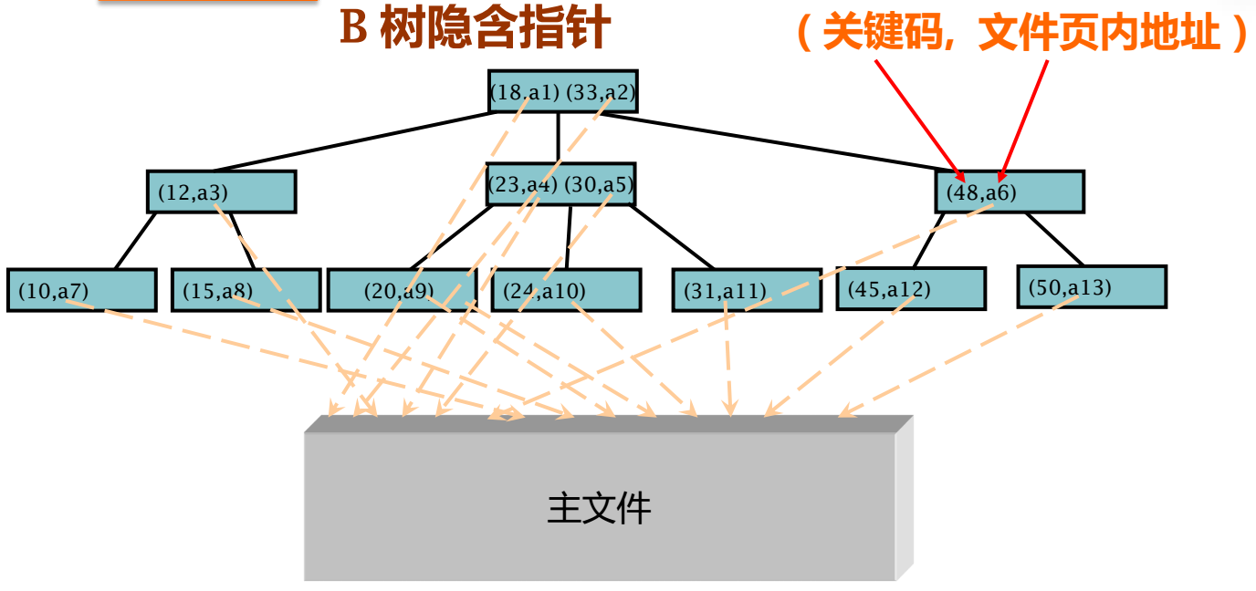
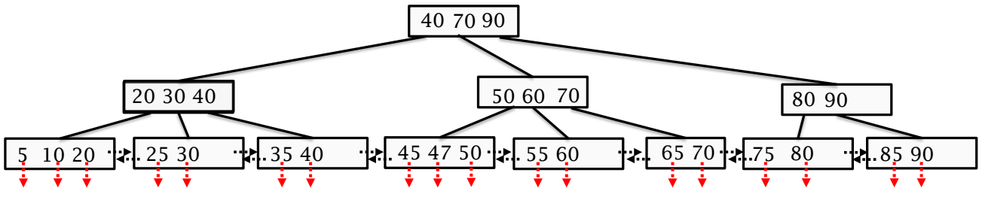
What is B⁺-Tree ?
区别于B-Tree
  内部节点仅保存关键字及子节点指针，所有数据信息存储于叶子节点中
  有k个子节点就有k个关键字
B⁺树
文件页内地址
主文件
Source: 高级数据结构与算法，北京大学

Slide 16
Updating B⁺-Tree
插入（分裂）
  Bottom-up
  保证上一层节点中有子节点的最大（或最小）关键字
3阶B⁺树插入15
15

Slide 17
Updating B⁺-Tree
插入（分裂）
  Bottom-up
  保证上一层节点中有子节点的最大（或最小）关键字
3阶B⁺树插入15
40 70 90
20 30 40
…
5 10
15 20
25 30
35 40

Slide 18
Updating B⁺-Tree
插入（分裂）
  Bottom-up
  保证上一层节点中有子节点的最大（或最小）关键字
3阶B⁺树插入15
40 70 90
10 20
30 40
…
5 10
15 20
25 30
35 40

Slide 19
Updating B⁺-Tree
插入（分裂）
  Bottom-up
  保证上一层节点中有子节点的最大（或最小）关键字
3阶B⁺树插入15完成
40 90
20 40
70 90
10 20
30 40
…
5 10
15 20
25 30
35 40

Slide 20
Updating B⁺-Tree
删除
  当关键码下溢出时，与左或右兄弟进行调整（甚至合并）
3阶B⁺树删除75
40 70 90
20 30 40
50 60 70
80 90
5 10 20
25 30
35 40
45 47 50
55 60
65 70
75 80
85 90

Slide 21
Updating B⁺-Tree
删除
  当关键码下溢出时，与左或右兄弟进行调整（甚至合并）
3阶B⁺树删除75
40 70 90
50 60 70
80 90
…
45 47 50
55 60
65 70
80 85 90

Slide 22
Updating B⁺-Tree
删除
  当关键码下溢出时，与左或右兄弟进行调整（甚至合并）
3阶B⁺树删除75
40 70 90
50 60 70
90
…
45 47 50
55 60
65 70
80 85 90

Slide 23
Updating B⁺-Tree
删除
  当关键码下溢出时，与左或右兄弟进行调整（甚至合并）
3阶B⁺树删除75完成
40 60 90
50 60
70 90
…
45 47 50
55 60
65 70
80 85 90

Slide 24
Advantages of B⁺-Tree Over B-Tree
非叶子节点不含需要查找的数据信息
  每个节点可以存储更多关键字，因而一次I/O操作的效率高，更适合文件索引系统
所有叶子节点包含全部关键字
  查找性能稳定
  数据遍历效率高
  支持range query，因而广泛用于数据库索引

Slide 25
Q&A
Thank you!

